Slide 1
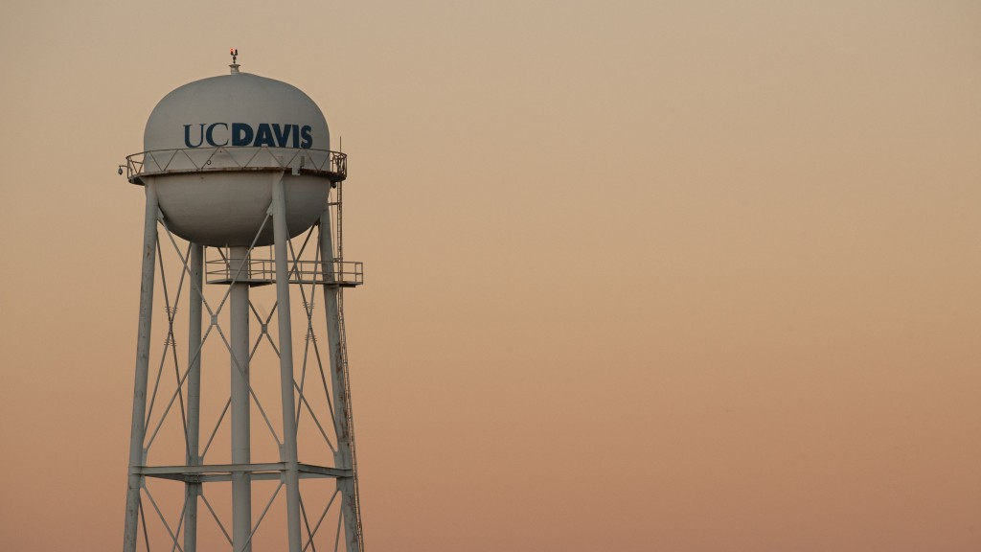
Network Leader Quarterly Call June 2023
Notes:
Name, Network & Pronouns As a volunteer leader, what have been your successes and/or stresses during this 2021-2022 year?

Slide 2
AGENDA
Registration Updates
Year in Review
Summer Socials
Homecoming/Athletics
Communication Norms
Notes:
Network Leader Community Wellness Successes and Stresses
FY23 Network Registration
Virtual Volunteer Leadership Conference
Picnic Day Around the World
Mid-Year Check-ins

Slide 3
Click this Link
https://alumni.ucdavis.edu/form/terms-and-conditions

Slide 4
Regional Network Registration 23-24
Arizona
Chicago
Colorado
Kern
France
Los Angeles
New England
Oregon
River Delta
New York
San Diego
Silicon Valley
Indonesia
Singapore
Washington DC
San Francisco

Slide 5
Special Interest & Affinity Networks 23-24
African and African American Alumni
Chicanx/Latinx Alumni
Iranian Alumni
Chorus Alumni
Mil-Net
Sword and Sandals

Slide 6
Our Year in Review
Throughout the last 12 months, our networks have hosted 65 events around the world
23 in California
12 National
20 International
9 Special Interest and Affinity

Slide 7
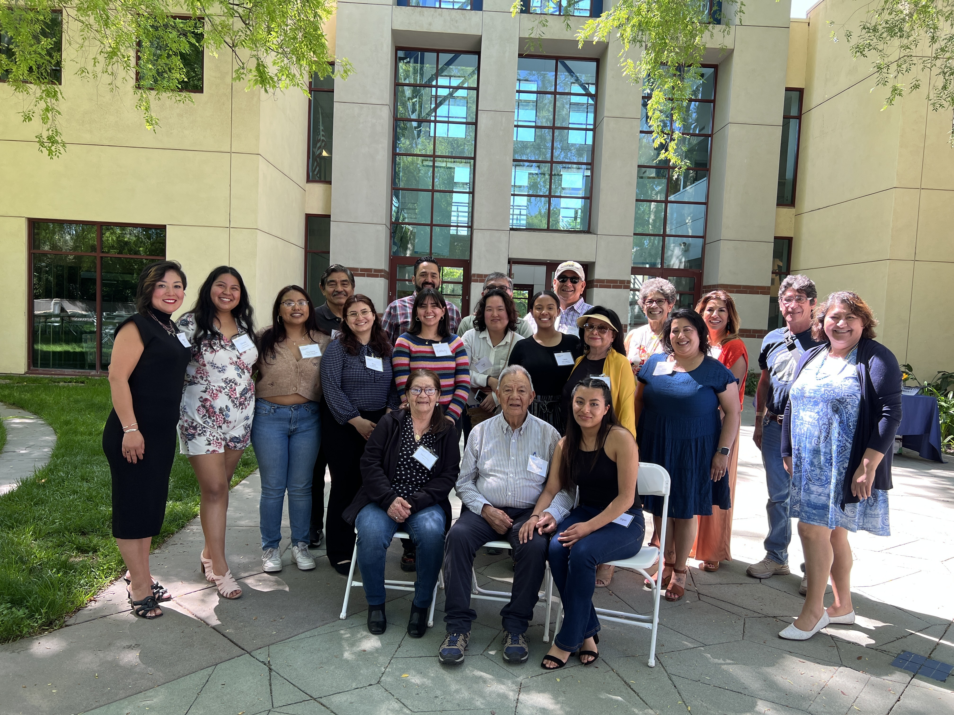
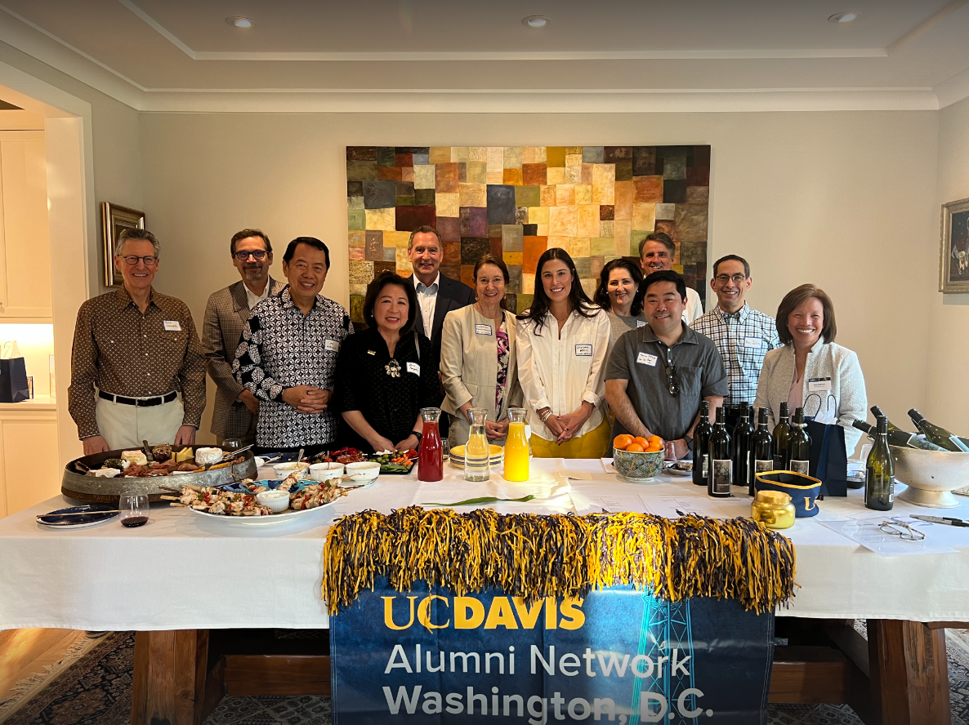
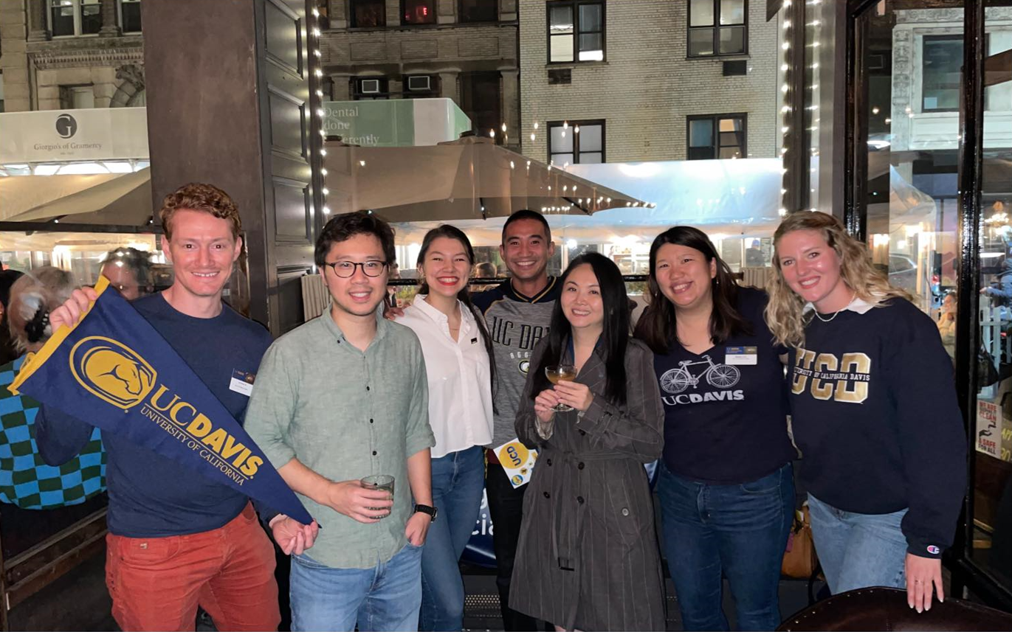
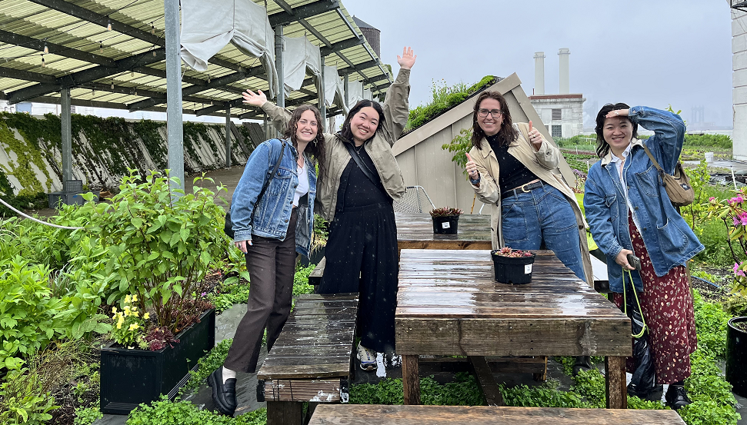
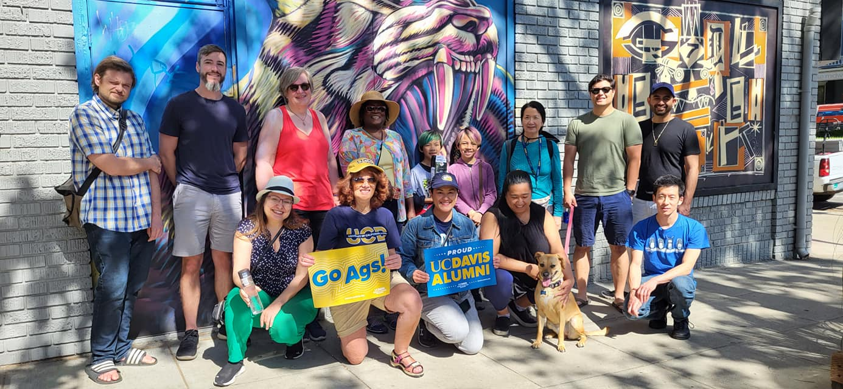
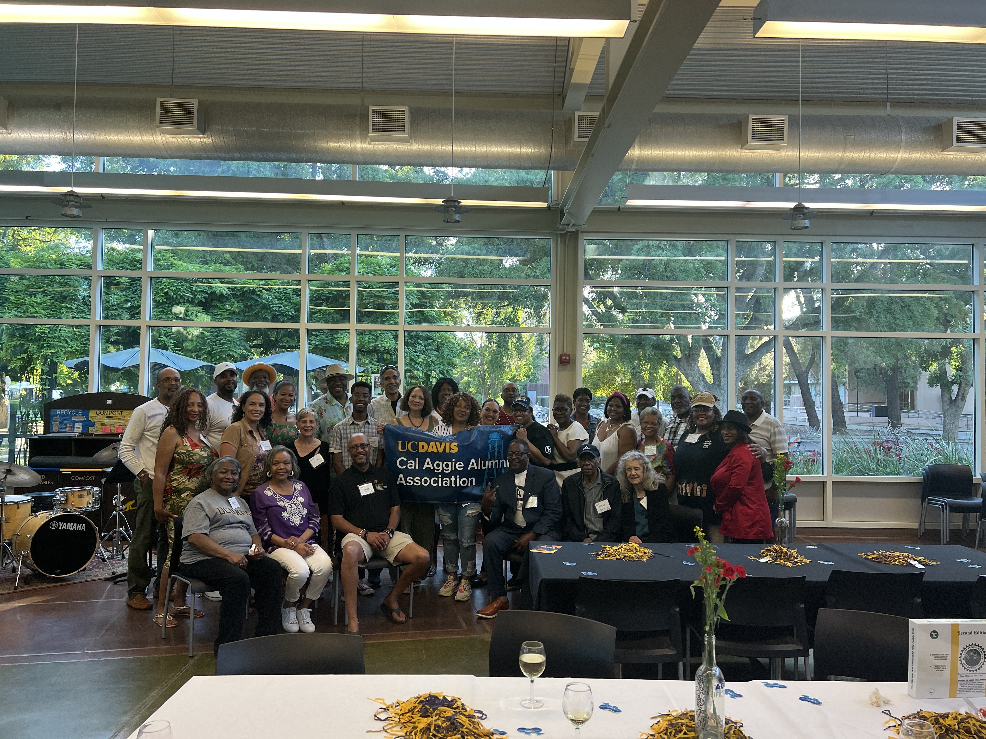
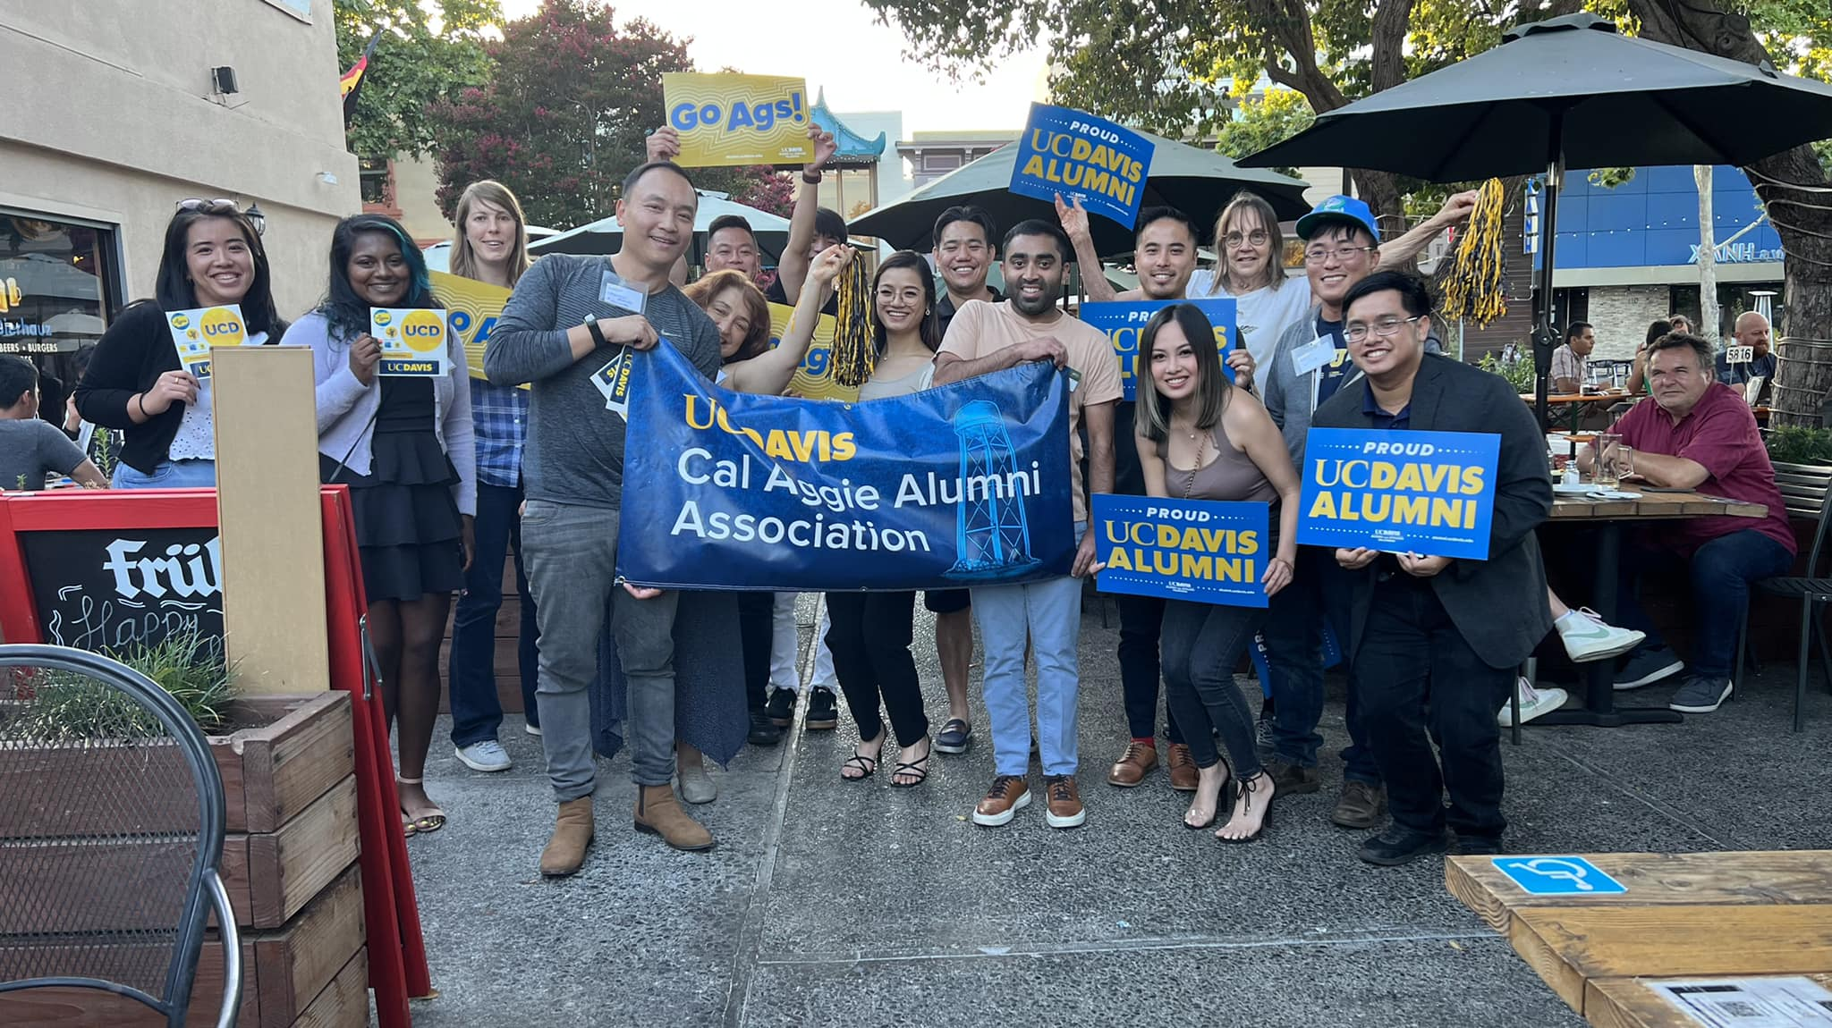
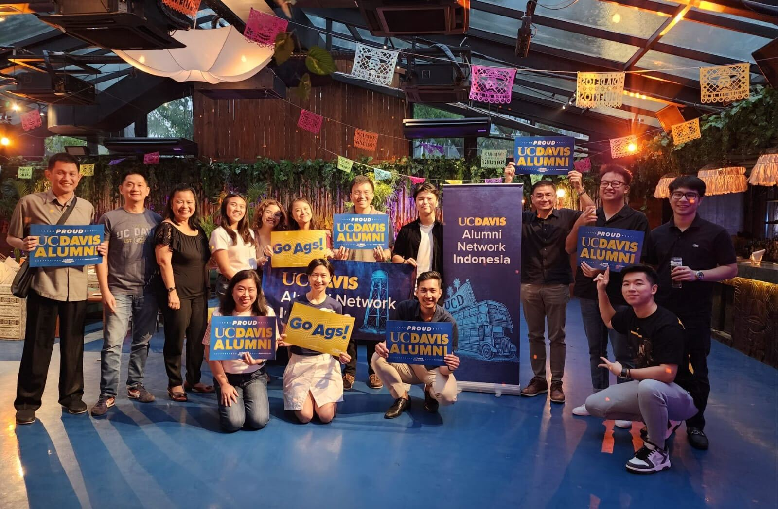

Slide 8
Summer Socials
Hosted by APFA and our Network Leaders
Upcoming APFA Events:
East Bay July 18th
South Bay July 19th
SF July 25th
LA/Orange County – Long Beach July 27th
LA/Glendale July 29th
San Diego July 28th
Upcoming Network Events
Singapore July 15th
Kern County August 27th

Slide 9
IMPORTANT DATES TO KNOW
Campus-Wide events to join in on
Picnic Day - Mid April every year
Summer Send offs – Plan for an event in June or July.
Homecoming - Mid-October
Fall Tailgating and Watch Parties
Mondavi and Manetti Events
Cultural & Community Events
Mooncake festival – September
Pride Month – June
Black History Month - February
Veterans Day - November
Cesar Chavez Day - March

Slide 10
Marketing
Newsletters and Social Media
Sacramento and Bay Area receive monthly newsletters
Included in those newsletters are regional events, campuswide news and membership promos
Regional Newsletters outside of SAC/BAY are sent when there is an event or promotion that is relevant.
Aggie Connections is monthly as well
Social Media:
Facebook events are created for all network events, usually posted by Ashley or network leader.
Instagram is currently only used by a few networks
Main CAAA Instagram and Facebook pages are used to promote alumni stories, campus events and some regional events.
Network LinkedIn Pages

Slide 11
COMMUNICATION NORMS
Be responsive and understanding of each other
Be open to feedback and suggestions
We will honor our commitments to each other and the team. If we say we will do something, we will do it.
We communicate decisions and relevant information quickly
We ensure that our meetings are effective & productive

Slide 12
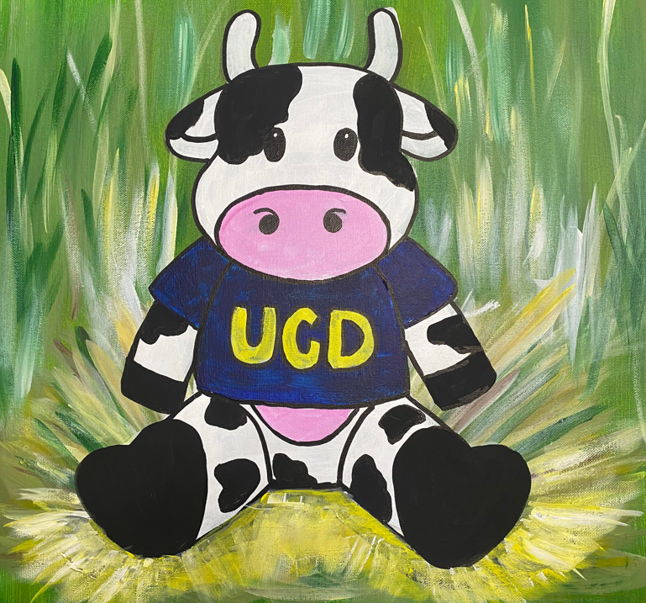
What we do as Staff Liaisons
What we need from you
Market events on website, Social Media and through emails
Coordinate multi-network events
Pull attendee data and constituent lists
Incentivize participation
Manage Social Media posts
Track budgets
Provide Insurance
Advance notice of plans
Fill out pre/post event forms in a timely manner
Responsive to communications from CAAA
Read the Network Leader Newsletter

Slide 13
What else?

